Slide 1
Data mining
Lecture 2: Data, Data Analysis, Pre-processing, Visualization

Slide 2
Chapter 2. Getting to Know Your Data
Data Objects and Attribute Types
Basic Statistical Descriptions of Data
Data Visualization
Measuring Data Similarity and Dissimilarity
Summary

Slide 3
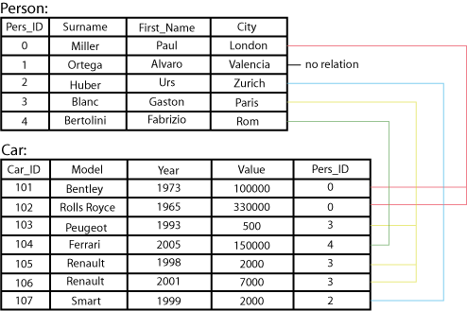
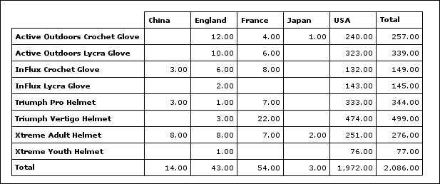
Types of Data Sets: (1) Record Data
Relational records
Relational tables, highly structured
Data matrix, e.g., numerical matrix, crosstabs
Transaction data
Document data: Term-frequency vector (matrix) of text documents

Slide 4
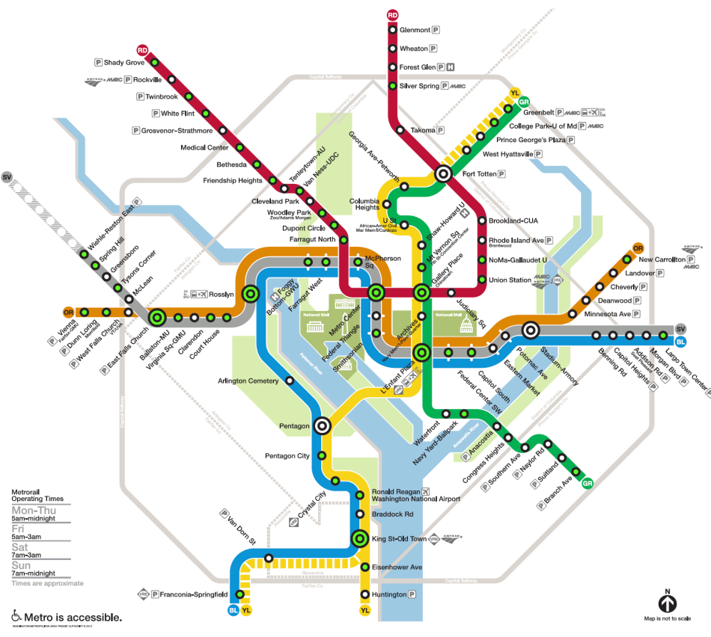

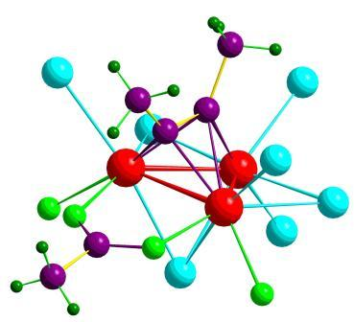

Types of Data Sets: (2) Graphs and Networks
Transportation network
World Wide Web
Molecular Structures
Social or information networks

Slide 5
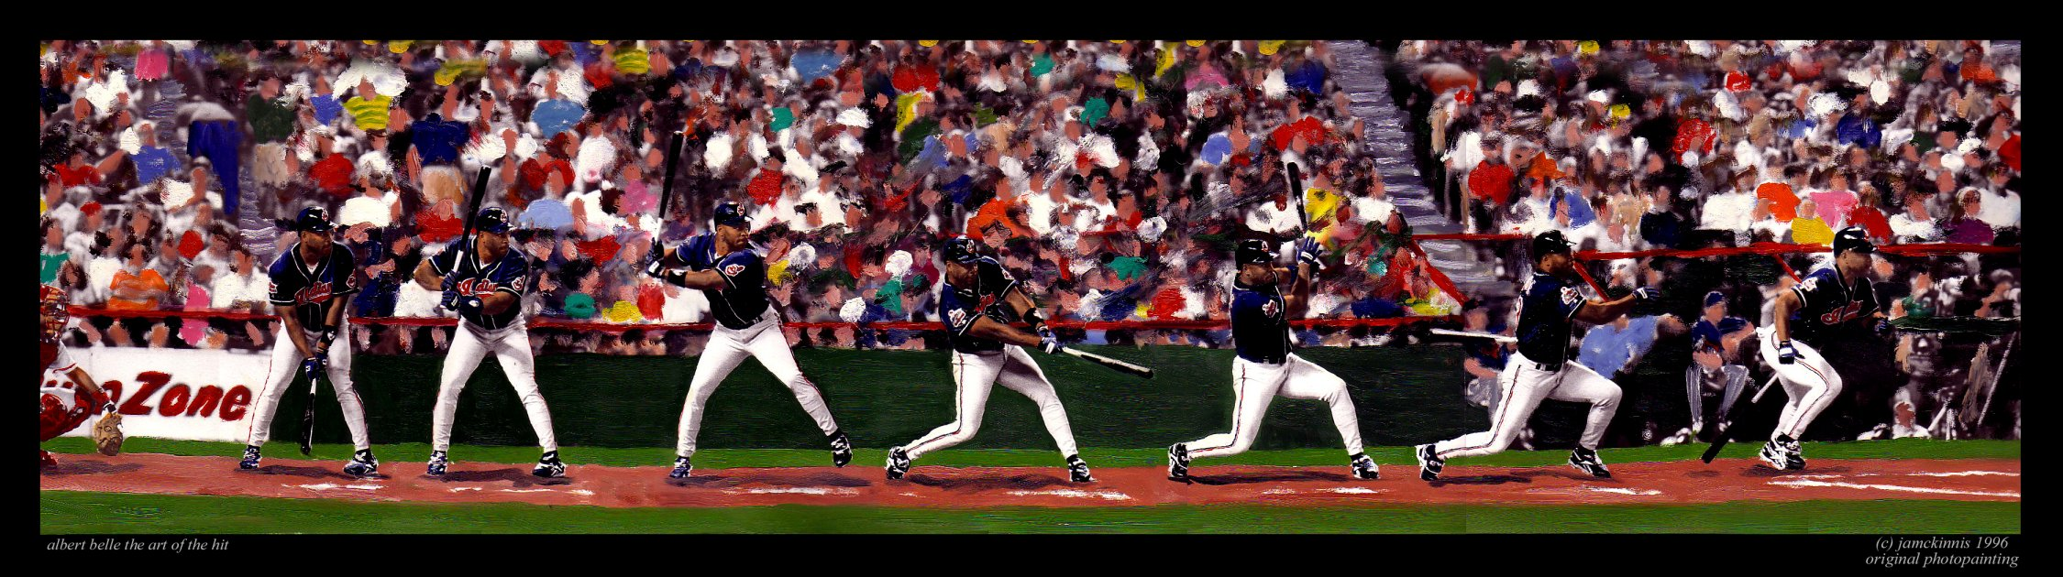
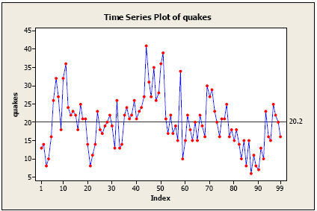
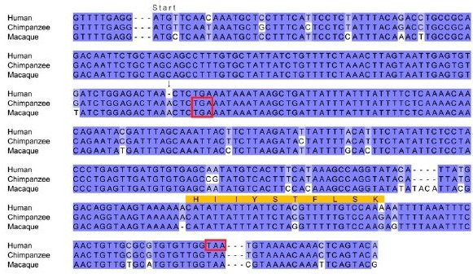
Types of Data Sets: (3) Ordered Data
Video data: sequence of images
Temporal data: time-series
Sequential Data: transaction sequences
Genetic sequence data

Slide 6
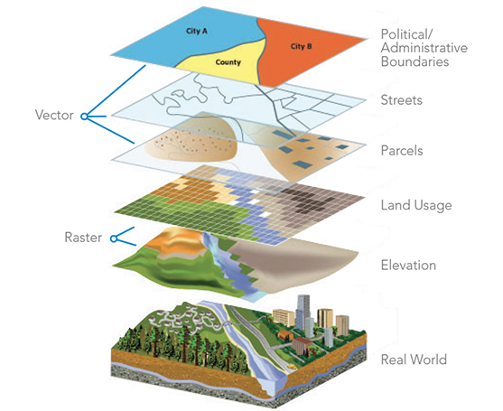

Types of Data Sets: (4) Spatial, image and multimedia Data
Spatial data: maps
Image data:
Video data:

Slide 7
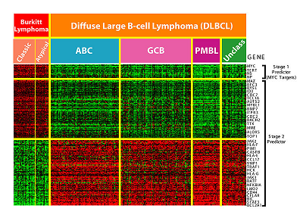

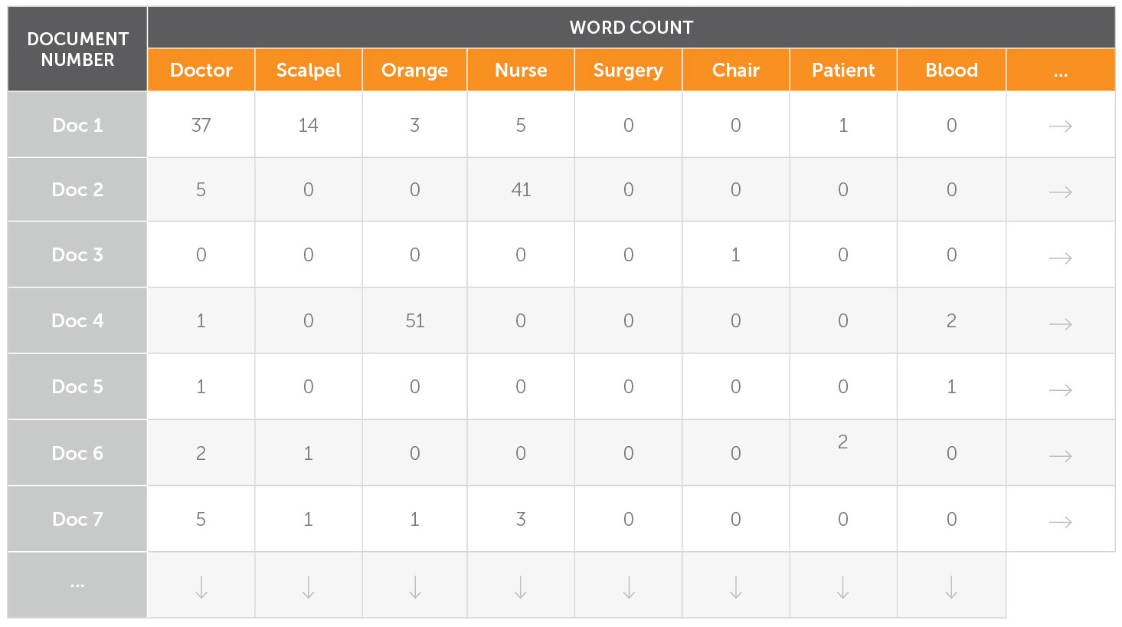
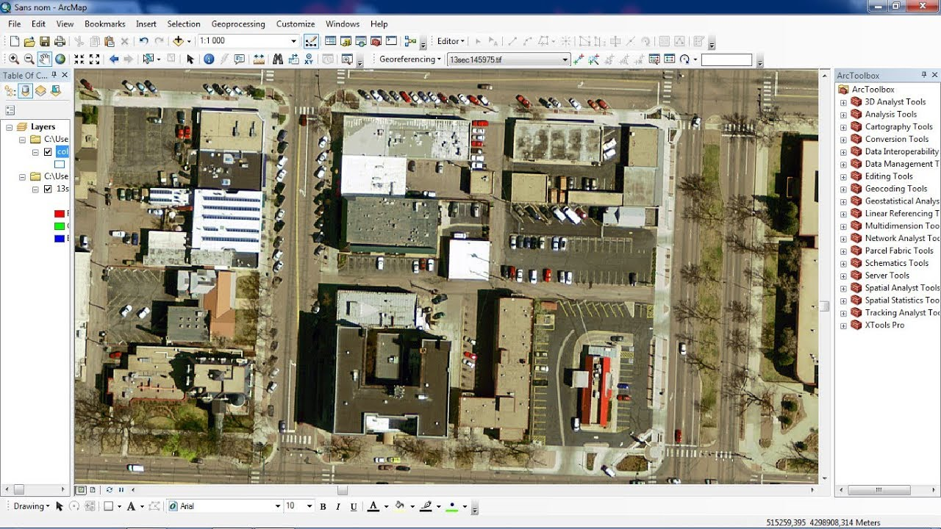
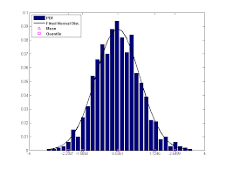
Important Characteristics of Structured Data
Dimensionality
Curse of dimensionality
Sparsity
Only presence counts
Opposite: density
Resolution
Patterns depend on the scale
Distribution
Centrality and dispersion

Slide 8
Data Objects
Data sets are made up of data objects
A data object represents an entity
Examples:
sales database: customers, store items, sales
medical database: patients, treatments
university database: students, professors, courses
Also called samples , examples, instances, data points, objects, tuples
Data objects are described by attributes
Database rows → data objects; columns → attributes

Slide 9
Attributes
Attribute (or dimensions, features, variables)
A data field, representing a characteristic or feature of a data object.
E.g., customer _ID, name, address
Types:
Nominal (e.g., red, blue)
Binary (e.g., {true, false})
Ordinal (e.g., {freshman, sophomore, junior, senior})
Numeric: quantitative
Interval-scaled: 100○C is interval scales
Ratio-scaled: 100○K is ratio scaled since it is twice as high as 50 ○K
Q1: Is student ID a nominal, ordinal, or interval-scaled data?
Q2: What about eye color? Or color in the color spectrum of physics?

Slide 10
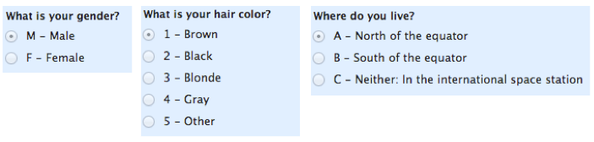

Attribute Types
Nominal: categories, states, or “names of things”
Hair_color = {auburn, black, blond, brown, grey, red, white}
marital status, occupation, ID numbers, zip codes
Binary
Nominal attribute with only 2 states (0 and 1)
Symmetric binary: both outcomes equally important
e.g., gender
Asymmetric binary: outcomes not equally important.
e.g., medical test (positive vs. negative)
Convention: assign 1 to most important outcome (e.g., HIV positive)
Ordinal
Values have a meaningful order (ranking) but magnitude between successive values is not known
Size = {small, medium, large}, grades, army rankings

Slide 11
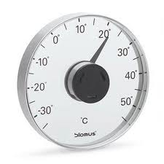
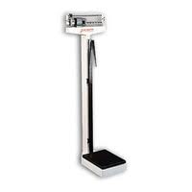
Numeric Attribute Types
10 degrees C + 10 degrees C = 20 degrees C.
20 degrees C is not twice as hot as 10 degrees C, however, because there is no such thing as “no temperature” when it comes to the Celsius scale.
When converted to Fahrenheit, it’s clear: 10C=50F and 20C=68F
We have absolute Zero, so ratios (multiply and divide) can be found.
Quantity (integer or real-valued)
Interval
Measured on a scale of equal-sized units
Values have order
E.g., temperature in C˚or F˚, calendar dates
No true zero-point
Ratio
Inherent zero-point
We can speak of values as being an order of magnitude larger than the unit of measurement (10 K˚ is twice as high as 5 K˚).
e.g., temperature in Kelvin, length, counts, monetary quantities

Slide 12
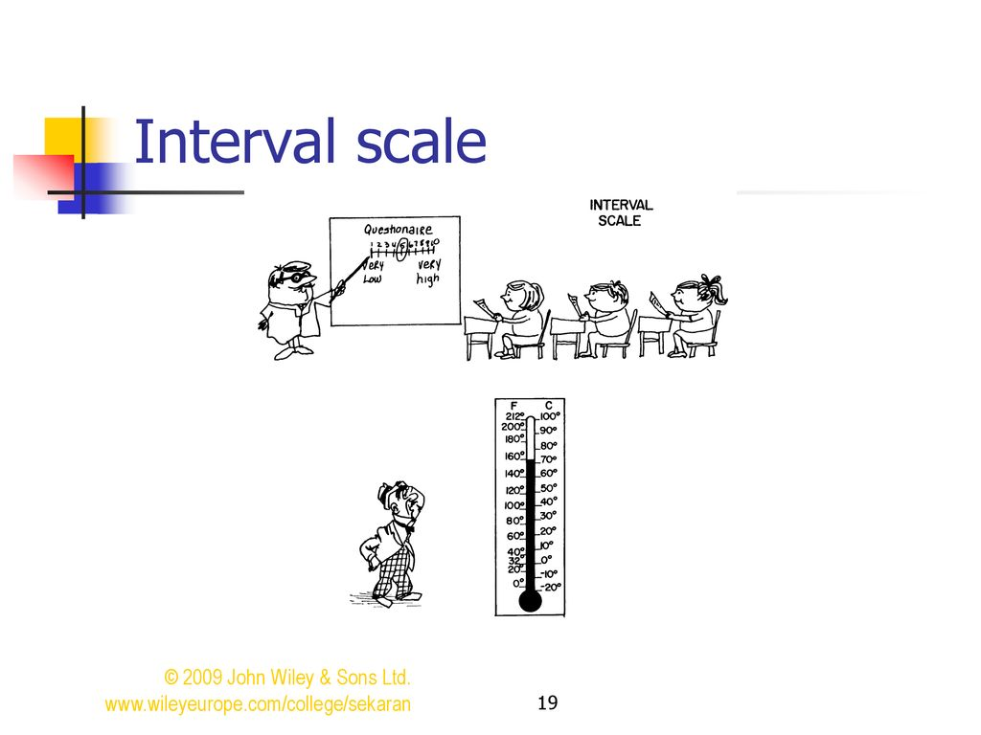
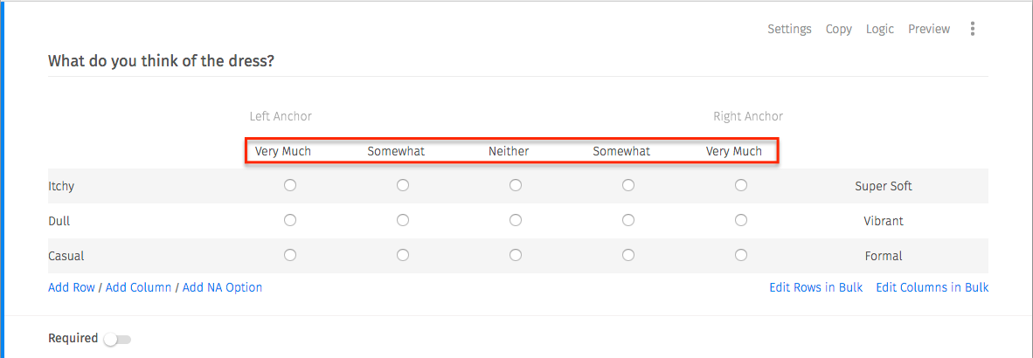



Slide 13
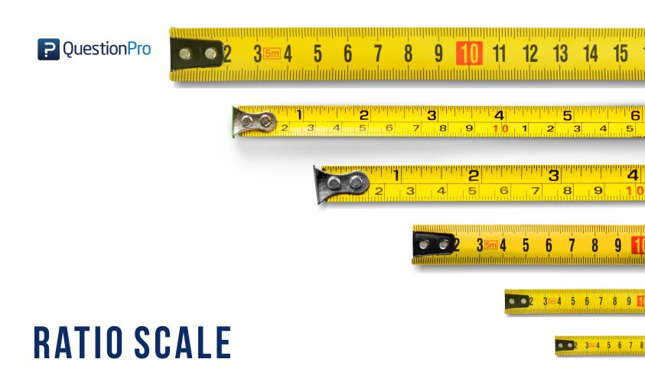
0 temperature does not mean no coldness
0 test scores mean really no score
0 age is really no age
etc.
It has absolute ZERO, interval scale does not have ZERO
What do you mean by this ----- 0 in interval scale does not mean the quantity does not exist, whereas in ratio it mean really ZERO

Slide 14
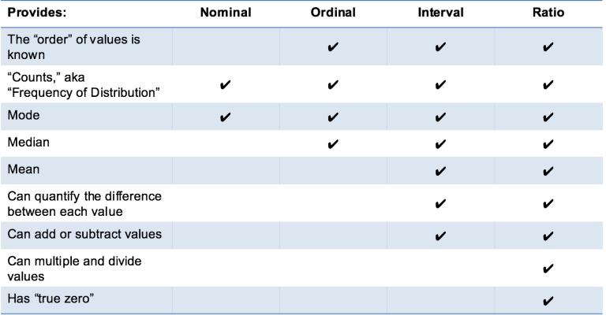

Slide 15
Discrete vs. Continuous Attributes
Discrete Attribute
Has only a finite or countably infinite set of values
E.g., zip codes, profession, or the set of words in a collection of documents
Sometimes, represented as integer variables
Note: Binary attributes are a special case of discrete attributes
Continuous Attribute (represented as floating point)
Has real numbers as attribute values
E.g., temperature, height, or weight
Practically, real values can only be measured and represented using a finite number of digits
Continuous attributes are typically represented as floating-point variables

Slide 17
Chapter 2. Getting to Know Your Data
Data Objects and Attribute Types
Basic Statistical Descriptions of Data
Data Visualization
Measuring Data Similarity and Dissimilarity
Summary

Slide 18
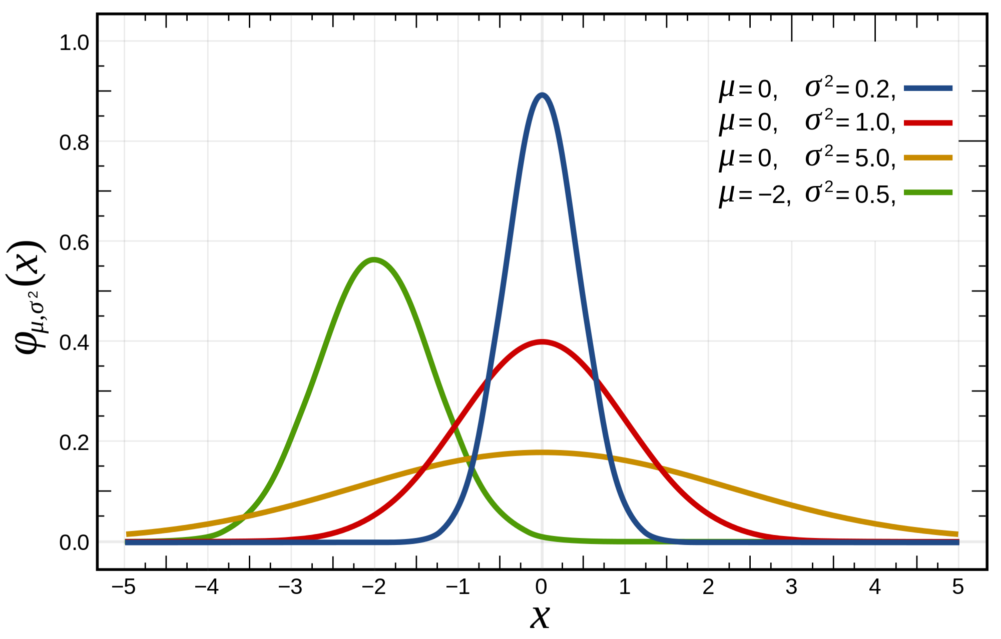
Basic Statistical Descriptions of Data
Motivation
To better understand the data: central tendency, variation and spread
Data dispersion characteristics
Median, max, min, quantiles, outliers, variance, ...
Numerical dimensions correspond to sorted intervals
Data dispersion:
Analyzed with multiple granularities of precision
Boxplot or quantile analysis on sorted intervals
Dispersion analysis on computed measures
Folding measures into numerical dimensions
Boxplot or quantile analysis on the transformed cube
Notes:
Note to self (MK): last part of slide does not clearly match slides that follow
Introduction slides:
In the current version, we only talk about numeric data. Can we add some materials about non-numeric data.
- text statistics, TF/IDF
- visualization of text statistics such as word cloud
- distribution of Internet (IN, SCC, OUT, …)
- visualization of social relationship (e.g., http://renlifang.msra.cn/)

Slide 19
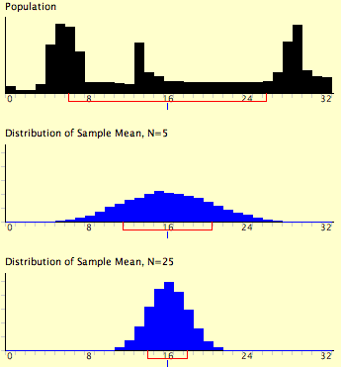
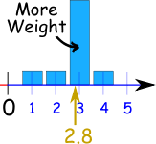
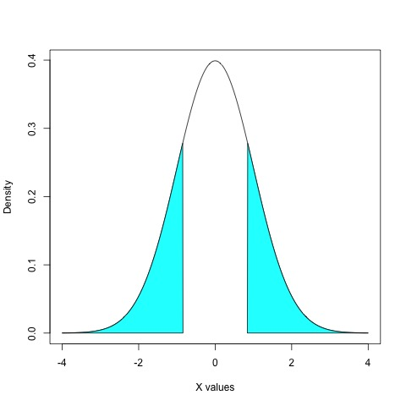
Measuring the Central Tendency: (1) Mean
Mean (algebraic measure) (sample vs. population):
Note: n is sample size and N is population size.
Weighted arithmetic mean:
Trimmed mean:
Chopping extreme values (e.g., Olympics gymnastics score computation)
Mean = 0.1 × 1 + 0.1 × 2 + 0.7 × 3 + 0.1 × 4 = 0.1 + 0.2 + 2.1 + 0.4 = 2.8

Slide 20
For N=2 and N=5

Slide 21
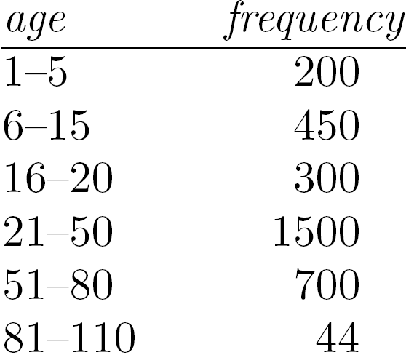
Measuring the Central Tendency: (2) Median
Median:
Middle value if odd number of values, or average of the middle two values otherwise
Estimated by interpolation (for grouped data):
Approximate median
Sum before the median interval
Interval width (L₂ – L₁)
Low interval limit

Slide 22
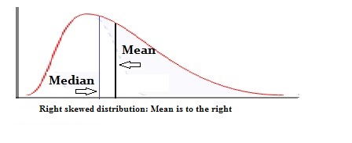
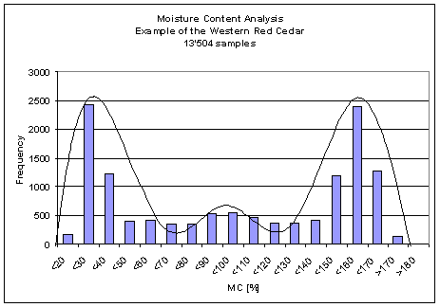
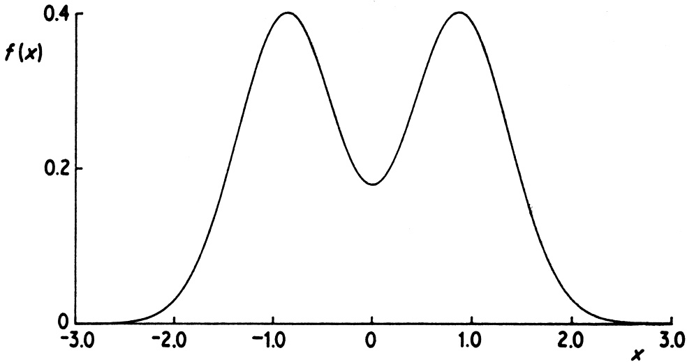
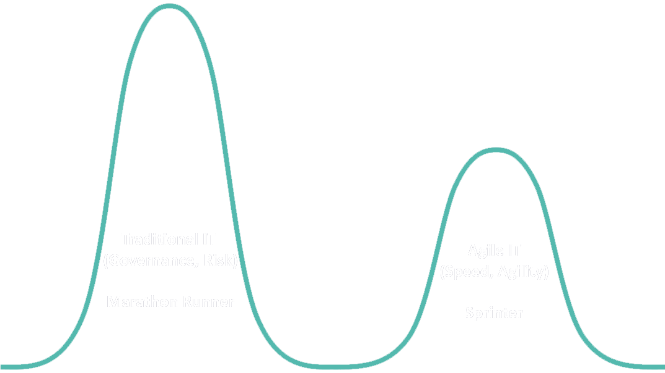
Measuring the Central Tendency: (3) Mode
Mode: Value that occurs most frequently in the data
Unimodal
Empirical formula:
Multi-modal
Bimodal
Trimodal

Slide 23
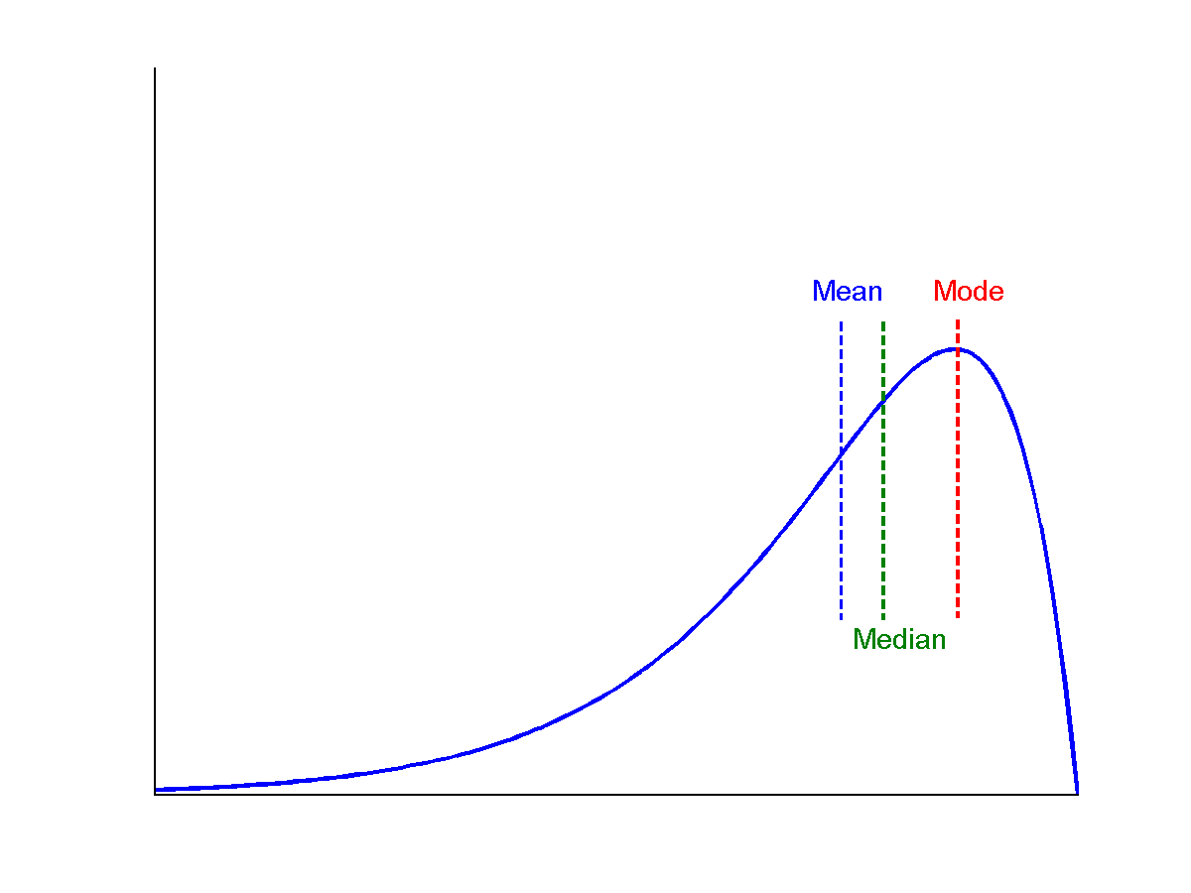
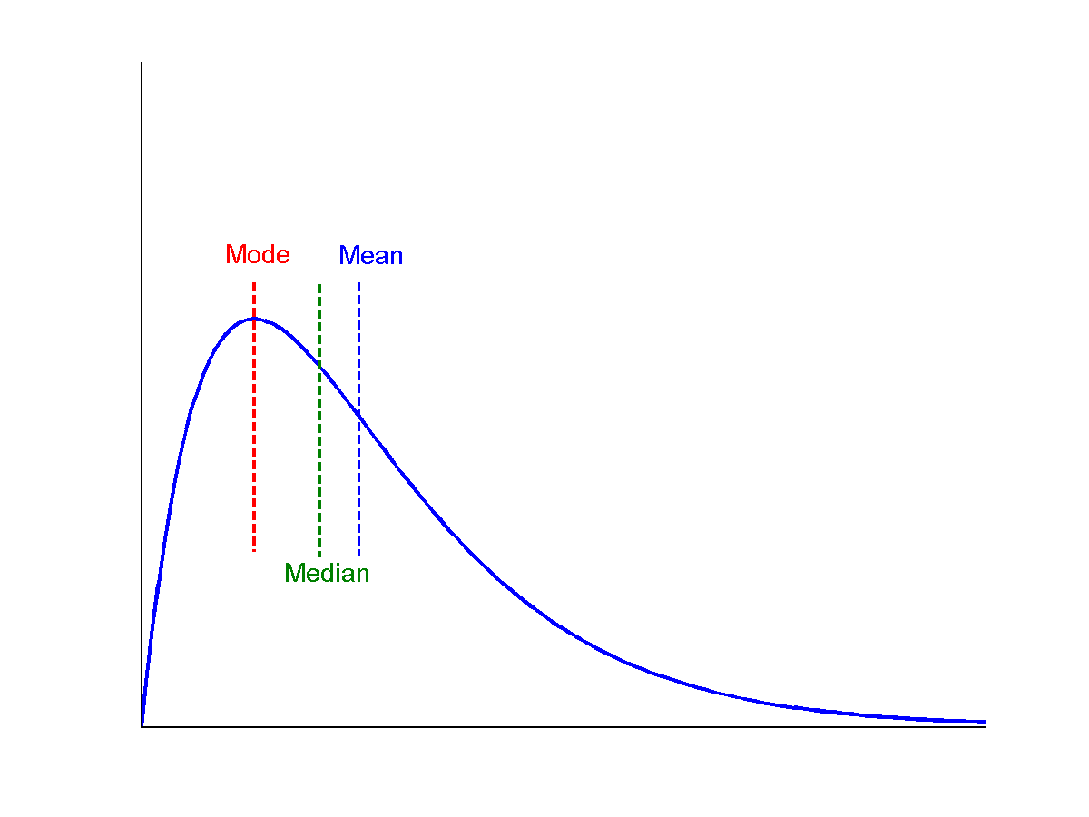
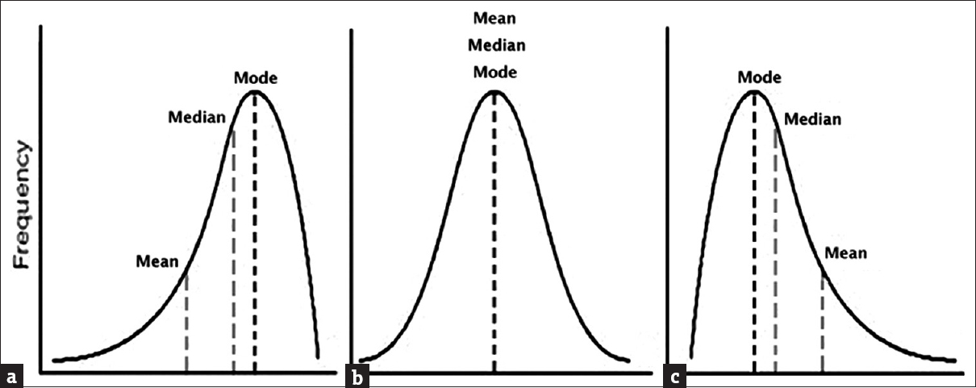
Symmetric vs. Skewed Data
symmetric
Median, mean and mode of symmetric, positively and negatively skewed data
negatively skewed
positively skewed
(a) Negatively skewed, (b) Normal, (c) Positively skewed

Slide 24
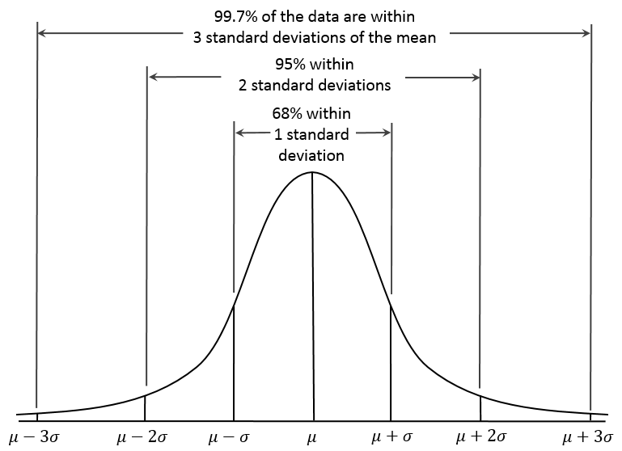
Properties of Normal Distribution Curve
← — ————Represent data dispersion, spread — ————→
Represent central tendency

Slide 25
Measures Data Distribution: Variance and Standard Deviation
Variance and standard deviation (sample: s, population: σ)
Variance: (algebraic, scalable computation)
Q: Can you compute it incrementally and efficiently?
Standard deviation s (or σ) is the square root of variance s² ⁽or σ²⁾

Slide 26
Graphic Displays of Basic Statistical Descriptions
Boxplot: graphic display of five-number summary
Histogram: x-axis are values, y-axis repres. frequencies
Quantile plot: each value x_{i} is paired with f_{i} indicating that approximately 100 f_{i} % of data are ≤ x_{i}
Quantile-quantile (q-q) plot: graphs the quantiles of one univariant distribution against the corresponding quantiles of another
Scatter plot: each pair of values is a pair of coordinates and plotted as points in the plane
Notes:
JH: Maybe we can remove Loess curve

Slide 27
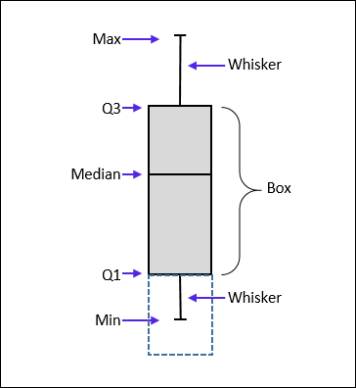
Measuring the Dispersion of Data: Quartiles & Boxplots
Quartiles: Q₁ (25th percentile), Q₃ (75th percentile)
Inter-quartile range: IQR = Q₃ – Q₁
Five number summary: min, Q₁, median, Q₃, max
Boxplot: Data is represented with a box
Q₁, Q₃, IQR: The ends of the box are at the first and third quartiles, i.e., the height of the box is IQR
Median (Q₂) is marked by a line within the box
Whiskers: two lines outside the box extended to Minimum and Maximum
Outliers: points beyond a specified outlier threshold, plotted individually
Outlier: usually, a value higher/lower than 1.5 x IQR

Slide 28
Example

Slide 29
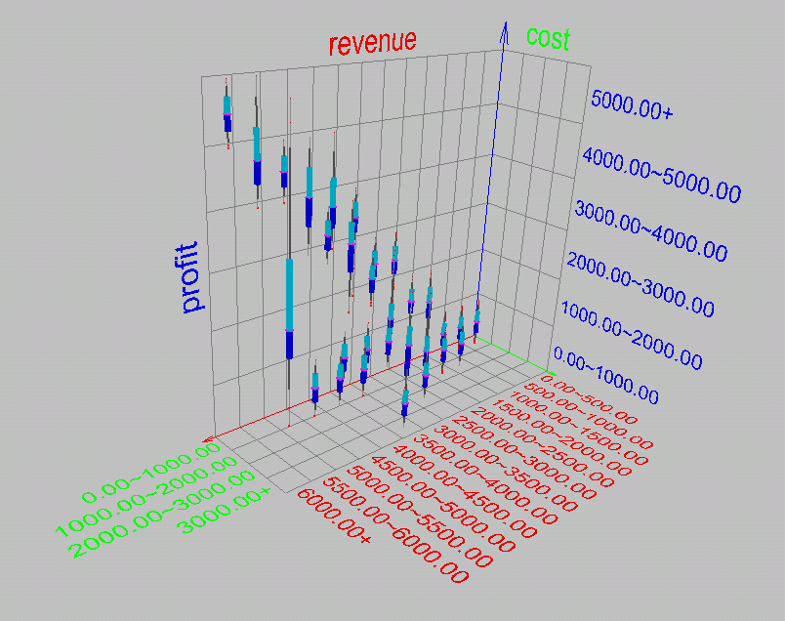
Visualization of Data Dispersion: 3-D Boxplots

Slide 30
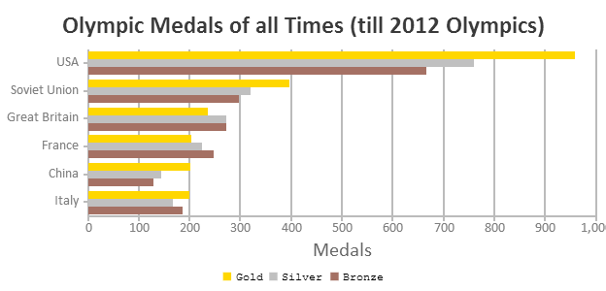
Histogram Analysis
Equ-bin
Eqv-freq
Histogram
Histogram: Graph display of tabulated frequencies, shown as bars
Differences between histograms and bar charts
Histograms are used to show distributions of variables while bar charts are used to compare variables
Histograms plot binned quantitative data while bar charts plot categorical data
Bars can be reordered in bar charts but not in histograms
Differs from a bar chart in that it is the area of the bar that denotes the value, not the height as in bar charts, a crucial distinction when the categories are not of uniform width
Bar chart
Notes:
JH: A better and BASIC histogram figure --- because this one overlaps with a later one!

Slide 31
Histograms Often Tell More than Boxplots
The two histograms shown in the left may have the same boxplot representation
The same values for: min, Q1, median, Q3, max
But they have rather different data distributions
Uni-modal vs multi-modal

Slide 32
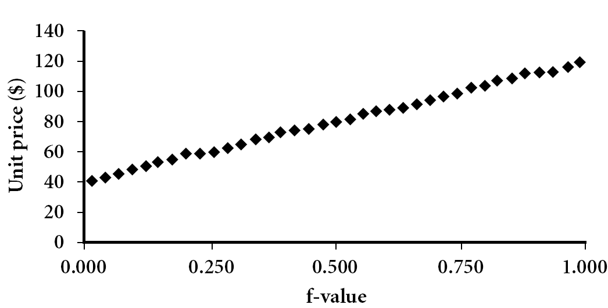
Quantile Plot
Displays all of the data (allowing the user to assess both the overall behavior and unusual occurrences)
Plots quantile information
For a data x_{i} data sorted in increasing order, f_{i} indicates that approximately 100 f_{i}% of the data are below or equal to the value x_{i}

Slide 33
Example
Divide the distribution in 6 equal divisions from 0 to 1.

Slide 34
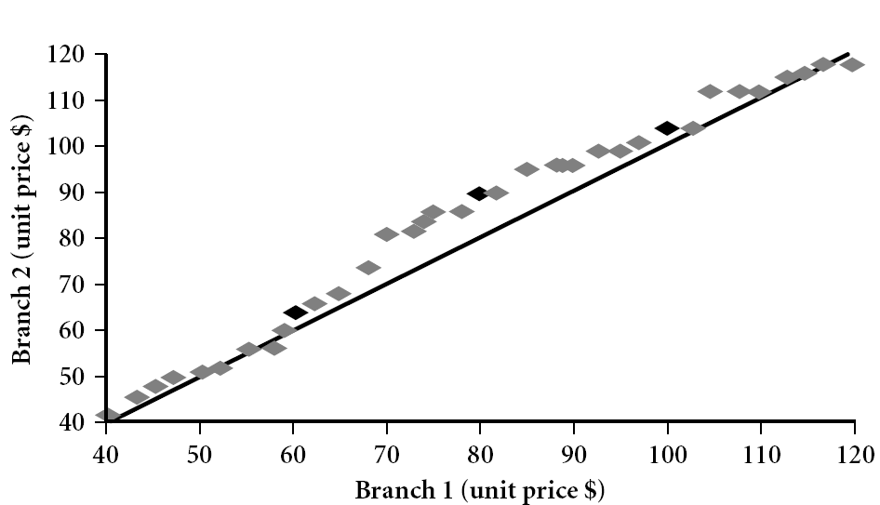
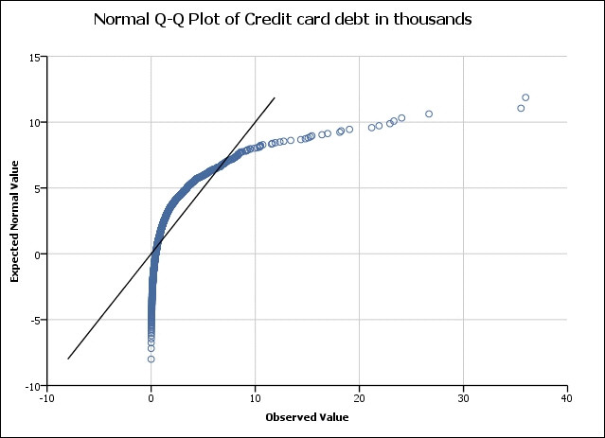
Quantile-Quantile (Q-Q) Plot
Graphs the quantiles of one univariate distribution against the corresponding quantiles of another
View: Is there is a shift in going from one distribution to another?
Example shows unit price of items sold at Branch 1 vs. Branch 2 for each quantile. Unit prices of items sold at Branch 1 tend to be lower than those at Branch 2
Notes:
Note: We need to label the dark plotted points as Q1, Median, Q3 – that would help in understanding this graph.
Tell audience: There is a shift in distribution of branch 1 WRT branch 2 in that the unit prices of items sold at branch 1 tend to be lower than those at branch 2.

Slide 35
Explaining Q-Q Plot
The quantile-quantile (q-q) plot is a graphical technique for determining if two data sets come from populations with a common distribution.
A q-q plot is a plot of the quantiles of the first data set against the quantiles of the second data set. By a quantile, we mean the fraction (or percent) of points below the given value. That is, the 0.3 (or 30%) quantile is the point at which 30% percent of the data fall below and 70% fall above that value.
A 45-degree reference line is also plotted. If the two sets come from a population with the same distribution, the points should fall approximately along this reference line. The greater the departure from this reference line, the greater the evidence for the conclusion that the two data sets have come from populations with different distributions.

Slide 36
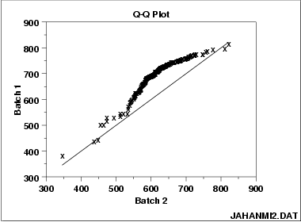
Example
These 2 batches do not appear to have come from populations with a common distribution.
The batch 1 values are significantly higher than the corresponding batch 2 values.
The differences are increasing from values 525 to 625. Then the values for the 2 batches get closer again.
https://www.itl.nist.gov/div898/handbook/eda/section3/eda33o.htm

Slide 37
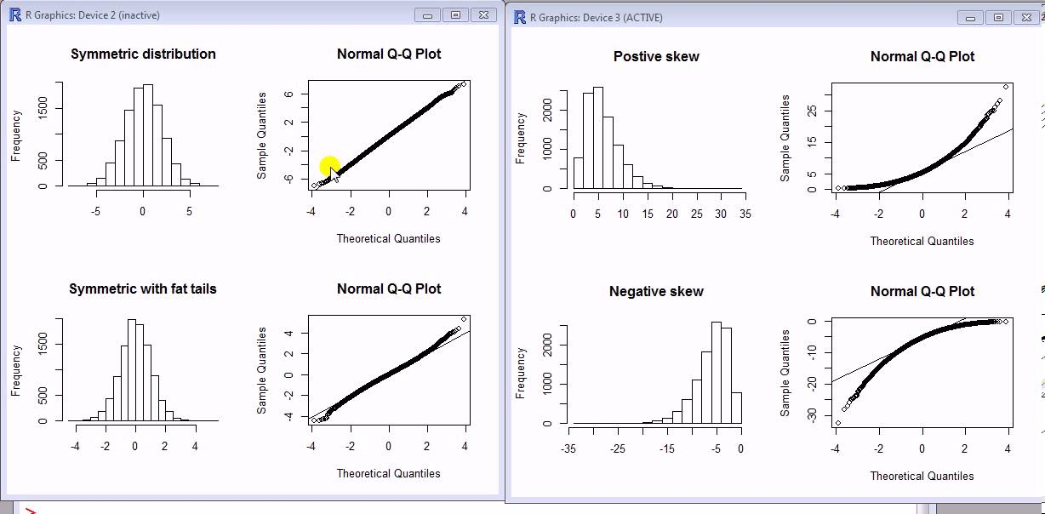
Is the data from a process flows a normal distribution ??? – Using Q-Q plot

Slide 38
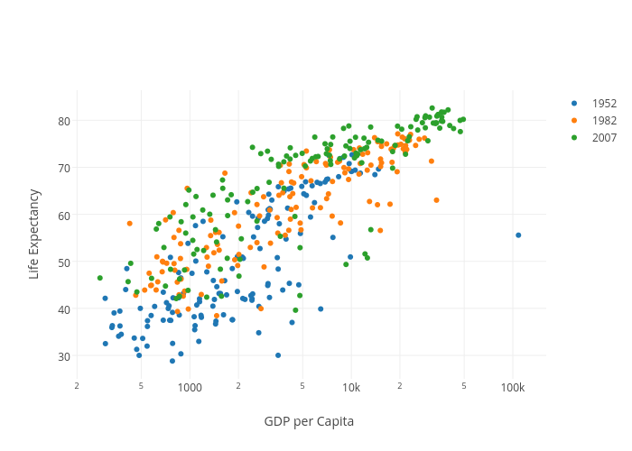
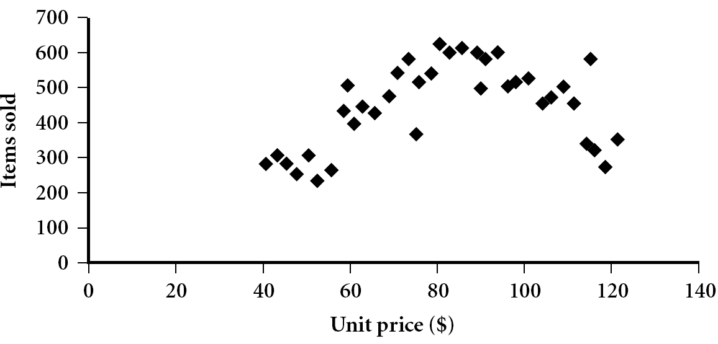
Scatter plot
Provides a first look at bivariate data to see clusters of points, outliers, etc.
Each pair of values is treated as a pair of coordinates and plotted as points in the plane
Notes:
Need a better and more MEANINGFUL scatter plot! -JH

Slide 39
Positively and Negatively Correlated Data
The left half fragment is positively correlated
The right half is negative correlated

Slide 40
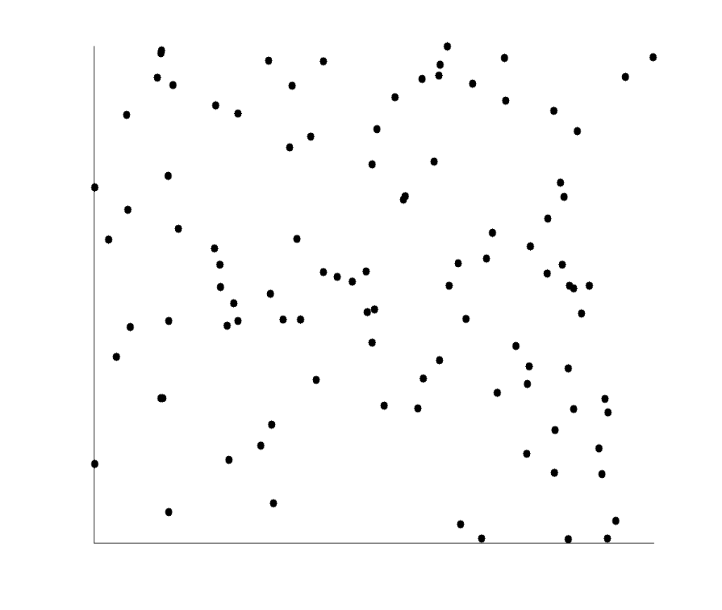
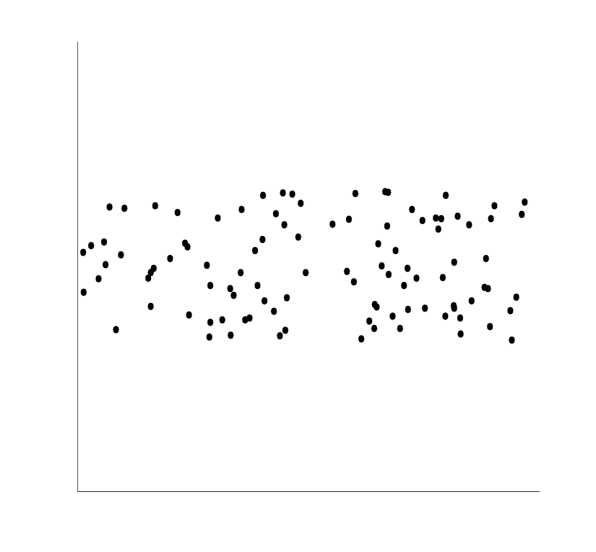
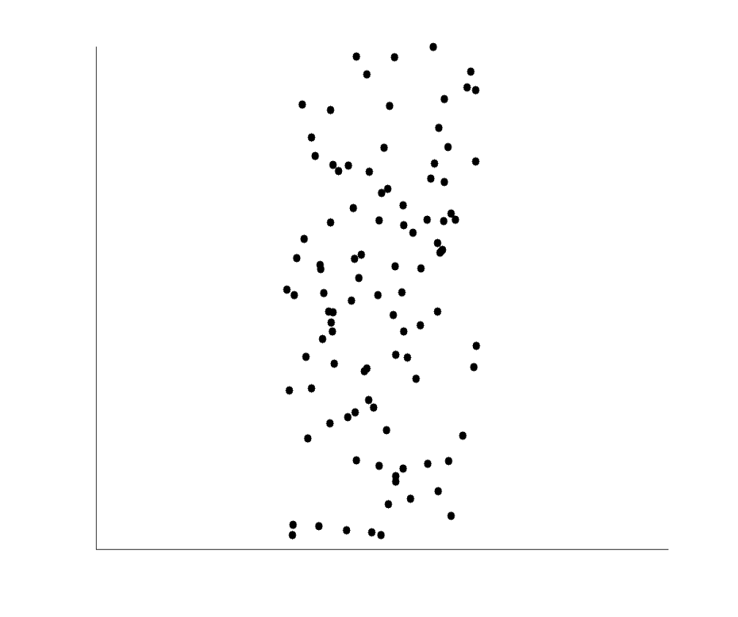
Uncorrelated Data

Slide 41
Example: Ceramic Factory Study
Run Lab Batch Y X1 X2 X3
1 1 1 608.781 -1 -1 -1
2 1 2 569.670 -1 -1 -1
3 1 1 689.556 -1 -1 -1
4 1 2 747.541 -1 -1 -1
5 1 1 618.134 -1 -1 -1
6 1 2 612.182 -1 -1 -1
7 1 1 680.203 -1 -1 -1
8 1 2 607.766 -1 -1 -1
9 1 1 726.232 -1 -1 -1
…..
……
Ceramic strength – Y
The factory has different batches and and made in different labs.
X1, X2, X3 are machine related factors
Table speed (X1)
Down feed rate (X2)
Wheel grit size (X3)
Direction (X4)
Batch wise analysis of strength
Lab wise analysis of strength
etc.
https://www.itl.nist.gov/div898/handbook/eda/section4/eda42a.htm

Slide 42
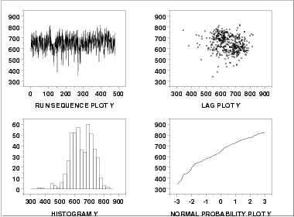
Basic Analysis
Run-Sequence Plot:
Most of the points are in the range 500 to 750. However, there are about half a dozen points in the 300 to 450 range that may require special attention.
Strength
The histogram (the lower left corner)
shows the response appears to be reasonably symmetric, but with a bimodal distribution.
The normal probability plot (the lower right corner)
shows some curvature indicating that distributions other than the normal may provide a better fit.
The lag plot (the upper right corner)
does not show any significant structure. This is another tool for detecting any potential time effect.

Slide 43
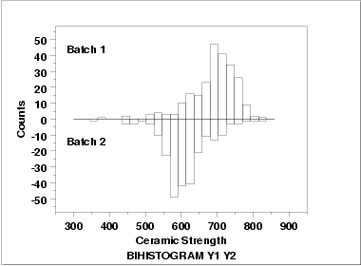
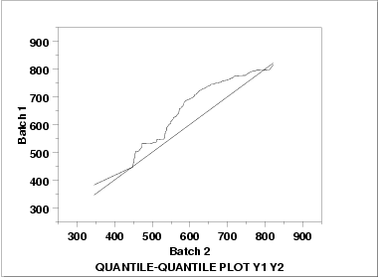
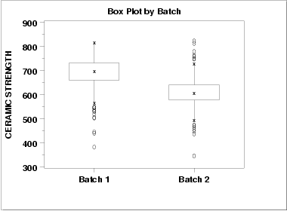
Batch Analysis
There does appear to be a batch effect.
The batch 1 responses are centered at 700 while the batch 2 responses are centered at 625. That is, the batch effect is approximately 75 units.
The variability is comparable for the 2 batches.
Batch 1 has some skewness in the lower tail. Batch 2 has some skewness in the center of the distribution, but not as much in the tails compared to batch 1.
Both batches have a few low-lying points.
Except for a few points in the right tail, the batch 1 values have higher quantiles than the batch 2 values. This implies that batch 1 has a greater location value than batch 2.

Slide 44
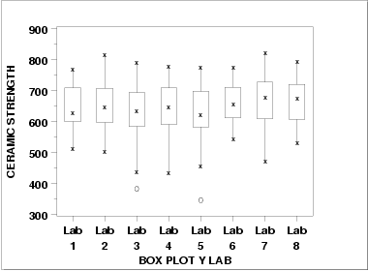


Lab wise Analysis
Overall: There is minor variation in the medians for the 8 labs.
The scales are relatively constant for the labs.
Two of the labs (3 and 5) have outliers on the low side.
Batch 1: Each of the labs has a median in the 650 to 700 range.
The variability is relatively constant across the labs.
Each of the labs has at least one outlier on the low side.
Batch 2: The medians are in the range 550 to 600.
There is a bit more variability, across the labs, for batch2 compared to batch 1.
Six of the eight labs show outliers on the high side. Three of the labs show outliers on the low side.

Slide 45
Chapter 2. Getting to Know Your Data
Data Objects and Attribute Types
Basic Statistical Descriptions of Data
Data Visualization
Measuring Data Similarity and Dissimilarity
Summary

Slide 46
Data Visualization
Why data visualization?
Gain insight into an information space by mapping data onto graphical primitives
Provide qualitative overview of large data sets
Search for patterns, trends, structure, irregularities, relationships among data
Help find interesting regions and suitable parameters for further quantitative analysis
Provide a visual proof of computer representations derived
Categorization of visualization methods:
Pixel-oriented visualization techniques
Geometric projection visualization techniques
Icon-based visualization techniques
Hierarchical visualization techniques
Visualizing complex data and relations
Notes:
CC (conference call) 08.11.02: Need to check Wiki to update references.

Slide 47
Pixel-Oriented Visualization Techniques
For a data set of m dimensions, create m windows on the screen, one for each dimension
The m dimension values of a record are mapped to m pixels at the corresponding positions in the windows
The colors of the pixels reflect the corresponding values
Data object
Income
(b) Credit Limit
(c) transaction volume
(d) age
Notes:
47
CC (conference call) 08.11.02: Need to check Wiki to update references.

Slide 48

Laying Out Pixels in Circle Segments
To save space and show the connections among multiple dimensions, space filling is often done in a circle segment
Representing a data record in circle segment
(b) Laying out pixels in circle segment
Representing about 265,000 50-dimensional Data Items with the ‘Circle Segments’ Technique
Notes:
48

Slide 49
Geometric Projection Visualization Techniques
Visualization of geometric transformations and projections of the data
Methods
Direct visualization
Scatterplot and scatterplot matrices
Landscapes
Projection pursuit technique: Help users find meaningful projections of multidimensional data
Prosection views
Hyperslice
Parallel coordinates
Notes:
CC 08/11/02: Need a good survey. JH or JP may find a good book on amazon in order to update this slide. JH’s colleagues may generate some images for book.
We may consider the following books.
Visualizing Data: Exploring and Explaining Data with the Processing Environment - Paperback - Illustrated (Jan 11, 2008) by Ben Fry.
JH: I have ordered the book.

Slide 50

Direct Data Visualization
Ribbons with Twists Based on Vorticity
Notes:
http://books.elsevier.com/companions/1558606890/pictures/Chapter_01/fig1-6b.gif

Slide 51

Scatterplot Matrices
Matrix of scatterplots (x-y-diagrams) of the k-dim. data
A total of k(k-1)/2 distinct scatterplots
Used by ermission of M. Ward, Worcester Polytechnic Institute

Slide 52

Landscapes
Visualization of the data as perspective landscape
The data needs to be transformed into a (possibly artificial) 2D spatial representation which preserves the characteristics of the data
Used by permission of B. Wright, Visible Decisions Inc.
news articles visualized as a landscape

Slide 53

Parallel Coordinates
n equidistant axes which are parallel to one of the screen axes and correspond to the attributes
The axes are scaled to the [minimum, maximum]: range of the corresponding attribute
Every data item corresponds to a polygonal line which intersects each of the axes at the point which corresponds to the value for the attribute

Slide 54

Parallel Coordinates of a Data Set

Slide 55
Icon-Based Visualization Techniques
Visualization of the data values as features of icons
Typical visualization methods
Chernoff Faces
Stick Figures
General techniques
Shape coding: Use shape to represent certain information encoding
Color icons: Use color icons to encode more information
Tile bars: Use small icons to represent the relevant feature vectors in document retrieval

Slide 56

Chernoff Faces
A way to display variables on a two-dimensional surface, e.g., let x be eyebrow slant, y be eye size, z be nose length, etc.
The figure shows faces produced using 10 characteristics—(head eccentricity, eye size, eye spacing, eye eccentricity, pupil size, eyebrow slant, nose size, mouth shape, mouth size, and mouth opening): Each assigned one of 10 possible values, generated using Mathematica (S. Dickson)
REFERENCE: Gonick, L. and Smith, W. The Cartoon Guide to Statistics. New York: Harper Perennial, p. 212, 1993
Weisstein, Eric W. "Chernoff Face." From MathWorld--A Wolfram Web Resource. mathworld.wolfram.com/ChernoffFace.html

Slide 57


Stick Figure
A census data figure showing age, income, gender, education, etc.
A 5-piece stick figure (1 body and 4 limbs w. different angle/length)
used by permission of G. Grinstein, University of Massachusettes at Lowell
Notes:
“two attributes mapped to axes, remaining attributes mapped to angle or length of limbs”. Look at texture pattern.

Slide 58





Hierarchical Visualization Techniques
Visualization of the data using a hierarchical partitioning into subspaces
Methods
Dimensional Stacking
Worlds-within-Worlds
Tree-Map
Cone Trees
InfoCube
Notes:
MK 08/10/18: Is it “Treemap” or “Tree-Map”? - inconsistent in this file.

Slide 59

Dimensional Stacking
Partitioning of the n-dimensional attribute space in 2-D subspaces, which are ‘stacked’ into each other
Partitioning of the attribute value ranges into classes. The important attributes should be used on the outer levels.
Adequate for data with ordinal attributes of low cardinality
But, difficult to display more than nine dimensions
Important to map dimensions appropriately

Slide 60
Dimensional Stacking
Used by permission of M. Ward, Worcester Polytechnic Institute
Visualization of oil mining data with longitude and latitude mapped to the outer x-, y-axes and ore grade and depth mapped to the inner x-, y-axes

Slide 61
Worlds-within-Worlds
Assign the function and two most important parameters to innermost world
Fix all other parameters at constant values - draw other (1 or 2 or 3 dimensional worlds choosing these as the axes)
Software that uses this paradigm
N–vision: Dynamic interaction through data glove and stereo displays, including rotation, scaling (inner) and translation (inner/outer)
Auto Visual: Static interaction by means of queries

Slide 62

Tree-Map
Screen-filling method which uses a hierarchical partitioning of the screen into regions depending on the attribute values
The x- and y-dimension of the screen are partitioned alternately according to the attribute values (classes)
Schneiderman@UMD: Tree-Map of a File System
Schneiderman@UMD: Tree-Map to support large data sets of a million items
Notes:
Picture: http://www.cs.umd.edu/hcil/treemap-history/

Slide 63
InfoCube
A 3-D visualization technique where hierarchical information is displayed as nested semi-transparent cubes
The outermost cubes correspond to the top level data, while the subnodes or the lower level data are represented as smaller cubes inside the outermost cubes, etc.
Notes:
JH: I have not found a good infocube picture on the web

Slide 64

Three-D Cone Trees
3D cone tree visualization technique works well for up to a thousand nodes or so
First build a 2D circle tree that arranges its nodes in concentric circles centered on the root node
Cannot avoid overlaps when projected to 2D
G. Robertson, J. Mackinlay, S. Card. “Cone Trees: Animated 3D Visualizations of Hierarchical Information”, ACM SIGCHI'91
Graph from Nadeau Software Consulting website: Visualize a social network data set that models the way an infection spreads from one person to the next
Notes:
http://nadeausoftware.com/articles/visualization

Slide 65


Visualizing Complex Data and Relations: Tag Cloud
Tag cloud: Visualizing user-generated tags
The importance of tag is represented by font size/color
Popularly used to visualize word/phrase distributions
KDD 2013 Research Paper Title Tag Cloud
Newsmap: Google News Stories in 2005

Slide 66




Visualizing Complex Data and Relations: Social Networks
Visualizing non-numerical data: social and information networks
organizing information networks
A typical network structure
A social network

Slide 67
Chapter 2. Getting to Know Your Data
Data Objects and Attribute Types
Basic Statistical Descriptions of Data
Data Visualization
Measuring Data Similarity and Dissimilarity
Summary

Slide 68
Similarity, Dissimilarity, and Proximity
Similarity measure or similarity function
A real-valued function that quantifies the similarity between two objects
Measure how two data objects are alike: The higher value, the more alike
Often falls in the range [0,1]: 0: no similarity; 1: completely similar
Dissimilarity (or distance) measure
Numerical measure of how different two data objects are
In some sense, the inverse of similarity: The lower, the more alike
Minimum dissimilarity is often 0 (i.e., completely similar)
Range [0, 1] or [0, ∞) , depending on the definition
Proximity usually refers to either similarity or dissimilarity

Slide 69
Data Matrix and Dissimilarity Matrix
Data matrix
A data matrix of n data points with l dimensions
Dissimilarity (distance) matrix
n data points, but registers only the distance d(i, j) (typically metric)
Usually symmetric, thus a triangular matrix
Distance functions are usually different for real, boolean, categorical, ordinal, ratio, and vector variables
Weights can be associated with different variables based on applications and data semantics

Slide 70


Slide 71
Standardizing Numeric Data
Z-score:
X: raw score to be standardized, μ: mean of the population, σ: standard deviation
the distance between the raw score and the population mean in units of the standard deviation
negative when the raw score is below the mean, “+” when above
An alternative way: Calculate the mean absolute deviation for sample size ‘n’
where
standardized measure (z-score):
Using mean absolute deviation is more robust than using standard deviation
Notes:
MK: For lecture, this may be OK here, but I think discussion of standardization/normalization is better kept all together in Chapter 3

Slide 72


Example
Suppose you want to rank students based on the performances in different subjects
One approach is to use z-score
Z score normalizes scores by changing data to zero-mean data
(How far the student stands from 0)
(+1 means exactly one std deviation away +ve)
(-1 means exactly one std deviation away –ve)
Z for student 1 Algebra scores = (60-50)/10 = 1;
After adding all z scores
Student 3 is an outlier
Anything above +3 or below -3

Slide 73

Example: Data Matrix and Dissimilarity Matrix
Data Matrix Attribute 1: x-axis, Attribute 2: y-axis
Dissimilarity Matrix (by Euclidean Distance)
Distance between x1 point and x2 point= sqrt((1-3)²+(2-5)²) = 3.61

Slide 74
Distance on Numeric Data: Minkowski Distance
Minkowski distance: A popular distance measure
where i = (x_{i1}, x_{i2}, …, x_{il}) and j = (x_{j1}, x_{j2}, …, x_{jl}) are two l-dimensional data objects, and p is the order (the distance so defined is also called L-p norm)
Properties
d(i, j) > 0 if i ≠ j, and d(i, i) = 0 (Positivity)
d(i, j) = d(j, i) (Symmetry)
d(i, j) ≤ d(i, k) + d(k, j) (Triangle Inequality)
A distance that satisfies these properties is a metric
Note: There are nonmetric dissimilarities, e.g., set differences

Slide 75
Special Cases of Minkowski Distance
p = 1: (L₁ norm) Manhattan (or city block) distance
E.g., the Hamming distance: the number of bits that are different between two binary vectors
p = 2: (L₂ norm) Euclidean distance
p → ∞: (L_{max} norm, L∞ norm) “supremum” distance
The maximum difference between any component (attribute) of the vectors

Slide 76
Example: Minkowski Distance at Special Cases
Manhattan (L₁)
D(x1,x2)=(|1-3| +|2-5|) = 2+3 = 5
Euclidean (L₂)
Supremum (L∞)
D(x1,x2)=max(|1-3|,|2-5|) = max(2,3 )= 3

Slide 77




Proximity Measure for Binary Attributes
A contingency table for binary data
Distance measure for symmetric binary variables:
Distance measure for asymmetric binary variables:
Jaccard coefficient (similarity measure for asymmetric binary variables):
Note: Jaccard coefficient is the same as “coherence”:
Object j
Object i
(a concept discussed in Pattern Discovery)

Slide 78
Example: Dissimilarity between Asymmetric Binary Variables
Mary
 | 1 | 0 | ∑_{row}
1 | 2 | 0 | 2
0 | 1 | 3 | 4
∑_{col} | 3 | 3 | 6
Jack
Gender is a symmetric attribute (not counted in)
The remaining attributes are asymmetric binary
Let the values Y and P be 1, and the value N be 0
Distance:
Jim
 | 1 | 0 | ∑_{row}
1 | 1 | 1 | 2
0 | 1 | 3 | 4
∑_{col} | 2 | 4 | 6
Jack
Mary
 | 1 | 0 | ∑_{row}
1 | 1 | 1 | 2
0 | 2 | 2 | 4
∑_{col} | 3 | 3 | 6
Y=1, N=0;
P=1, N=0;
Jim

Slide 79
Proximity Measure for Categorical Attributes
Categorical data, also called nominal attributes
Example: Color (red, yellow, blue, green), profession, etc.
Method 1: Simple matching
m: # of matches, p: total # of variables
Method 2: Use a large number of binary attributes
Creating a new binary attribute for each of the M nominal states

Slide 80
Ordinal Variables
Let r be:{1,2,3,4}
Z(fresh)=(1-1)/(4-1) =0
Z(soph)=(2-1)/(4-1)=1/3
Z(jun)=(3-1)/(4-1)=2/3
Z(sen)=(4-1)/(4-1)=1
Dist(fres,sop)=(1/3)-0=1/3
Dist(fres,sen)=1-0=0
Dist(jun,sen)=1-2/3 = 1/3
An ordinal variable can be discrete or continuous
Order is important, e.g., rank (e.g., freshman, sophomore, junior, senior)
Can be treated like interval-scaled
Replace an ordinal variable value by its rank:
Map the range of each variable onto [0, 1] by replacing i-th object in the f-th variable by
Example: freshman: 0; sophomore: 1/3; junior: 2/3; senior 1
Then distance: d(freshman, senior) = 1, d(junior, senior) = 1/3
Compute the dissimilarity using methods for interval-scaled variables

Slide 81
Attributes of Mixed Type
A dataset may contain all attribute types
Nominal, symmetric binary, asymmetric binary, numeric, and ordinal
One may use a weighted formula to combine their effects:
If f is numeric: Use the normalized distance
If f is binary or nominal: d_{ij}^{(f)} = 0 if x_{if} = x_{jf}; or d_{ij}^{(f)} = 1 otherwise
If f is ordinal
Compute ranks z_{if} (where )
Treat z_{if} as interval-scaled

Slide 82

Cosine Similarity of Two Vectors
A document can be represented by a bag of terms or a long vector, with each attribute recording the frequency of a particular term (such as word, keyword, or phrase) in the document
Other vector objects: Gene features in micro-arrays
Applications: Information retrieval, biologic taxonomy, gene feature mapping, etc.
Cosine measure: If d₁ and d₂ are two vectors (e.g., term-frequency vectors), then
where • indicates vector dot product, ||d||: the length of vector d

Slide 83

Example: Calculating Cosine Similarity
Calculating Cosine Similarity:
where • indicates vector dot product, ||d||: the length of vector d
Ex: Find the similarity between documents 1 and 2.
d₁ = (5, 0, 3, 0, 2, 0, 0, 2, 0, 0) d₂ = (3, 0, 2, 0, 1, 1, 0, 1, 0, 1)
First, calculate vector dot product
d₁•d₂ = 5 X 3 + 0 X 0 + 3 X 2 + 0 X 0 + 2 X 1 + 0 X 1 + 0 X 1 + 2 X 1 + 0 X 0 + 0 X 1 = 25
Then, calculate ||d₁|| and ||d₂||
Calculate cosine similarity: cos(d₁, d₂ ) = 25/ (6.481 X 4.12) = 0.94

Slide 84



KL Divergence: Comparing Two Probability Distributions
The Kullback-Leibler (KL) divergence: Measure the difference between two probability distributions over the same variable x
From information theory, closely related to relative entropy, information divergence, and information for discrimination
D_{KL}(p(x) || q(x)): divergence of q(x) from p(x), measuring the information lost when q(x) is used to approximate p(x)
Ack.: Wikipedia entry: The Kullback-Leibler (KL) divergence
Discrete form
Continuous form

Slide 85





Worms – Teeth Analysis
Dkl (Observed ∣∣ Uniform)=0.338
Dkl (Observed ∣∣ Binomial)=0.477
https://www.countbayesie.com/blog/2017/5/9/kullback-leibler-divergence-explained

Slide 86
More on KL Divergence
The KL divergence measures the expected number of extra bits required to code samples from p(x) (“true” distribution) when using a code based on q(x), which represents a theory, model, description, or approximation of p(x)
The KL divergence is not a distance measure, not a metric: asymmetric, not satisfy triangular inequality (D_{KL}(P‖Q) does not equal D_{KL}(Q‖P))
In applications, P typically represents the "true" distribution of data, observations, or a precisely calculated theoretical distribution, while Q typically represents a theory, model, description, or approximation of P.
The Kullback–Leibler divergence from Q to P, denoted D_{KL}(P‖Q), is a measure of the information gained when one revises one's beliefs from the prior probability distribution Q to the posterior probability distribution P. In other words, it is the amount of information lost when Q is used to approximate P.
The KL divergence is sometimes also called the information gain achieved if P is used instead of Q. It is also called the relative entropy of P with respect to Q.

Slide 87
Subtlety at Computing the KL Divergence
Base on the formula, D_{KL}(P,Q) ≥ 0 and D_{KL}(P || Q) = 0 if and only if P = Q
How about when p = 0 or q = 0?
lim_{p→0} p log p = 0
when p != 0 but q = 0, D_{KL}(p || q) is defined as ∞, i.e., if one event e is possible (i.e., p(e) > 0), and the other predicts it is absolutely impossible (i.e., q(e) = 0), then the two distributions are absolutely different
However, in practice, P and Q are derived from frequency distributions, not counting the possibility of unseen events. Thus smoothing is needed
Example: P : (a : 3/5, b : 1/5, c : 1/5). Q : (a : 5/9, b : 3/9, d : 1/9)
need to introduce a small constant ϵ, e.g., ϵ = 10⁻³
The sample set observed in P, SP = {a, b, c}, SQ = {a, b, d}, SU = {a, b, c, d}
Smoothing, add missing symbols to each distribution, with probability ϵ
P′ : (a : 3/5 − ϵ/3, b : 1/5 − ϵ/3, c : 1/5 − ϵ/3, d : ϵ)
Q′ : (a : 5/9 − ϵ/3, b : 3/9 − ϵ/3, c : ϵ, d : 1/9 − ϵ/3)
D_{KL}(P’ || Q’) can then be computed easily

Slide 88
Chapter 2. Getting to Know Your Data
Data Objects and Attribute Types
Basic Statistical Descriptions of Data
Data Visualization
Measuring Data Similarity and Dissimilarity
Summary

Slide 89
Summary
Data attribute types: nominal, binary, ordinal, interval-scaled, ratio-scaled
Many types of data sets, e.g., numerical, text, graph, Web, image.
Gain insight into the data by:
Basic statistical data description: central tendency, dispersion, graphical displays
Data visualization: map data onto graphical primitives
Measure data similarity
Above steps are the beginning of data preprocessing
Many methods have been developed but still an active area of research
Notes:
08/10/23: This slide was out of date. Draft of new version above.
Cut out the following:
Data description, data exploration, and measure data similarity set the basis for quality data preprocessing
A lot of methods have been developed but data preprocessing still an active area of research

